Slide 2
2 Peter 1:1-4

Slide 3

"To give one's word to do or not to do something; to give cause for expectation; to agree to give; to assure by a promise; to give grounds for hope."

Slide 4
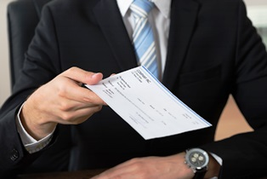

Promises a Part of Everyday Lives
We should never make promises we do not intend to keep!
Revelation 21:8

Slide 5
Three Facts That Determine The Worth Of A Promise
2 Peter 1:1-4

Slide 6
Three Facts That Determine The Worth Of A Promise
1. Value Of The Things Promised
  2 Peter 1:1-4 “exceeding great and precious”
  Matthew 16:26 “what will a man give in exchange for his soul?”
  Forgiveness, Peace, Joy and Eternal Life!
  THEY NEVER FAIL!
  2 Peter 3:9 “the Lord is not slack concerning His promise, as some count slackness”
  Precious because ALL earthly wealth can not buy them!
  Titus 1:1,2 “God, who cannot lie, promised before time began”
  Summed in in one glorious word – SALVATION!
  1 John 2:24,25

Slide 7
Three Facts That Determine The Worth Of A Promise
2. Character Of The Promisor-
  Malachi 3:6 “For I am the Lord, I do not change”
  God is able to fulfill EVERY PROMISE He makes!
  God’s OMNIPOTENCE is behind His promises!
  Romans 4:20,21 “what He had promised He was able to perform.”
  God has both the CHARACTER and the QUALITIES that make His promises worth something!
  “Standing on the promises that cannot fail…”

Slide 8
Three Facts That Determine The Worth Of A Promise
3. Nature Of God’s Promises-
  Some Things God Has Not Promised:
    1. Another chance after death! Hebrews 9:27; 2 Corinthians 6:2
    2. Another Day To Live! James 4:13,14
    3. To Save Anyone Outside The Church! Act 2:47; Colossians 1:18; 2 Timothy 2:10
    4. A Life Free From Hardships! James 1:2,3,12

Slide 9
Three Facts That Determine The Worth Of A Promise
All of God’s Promises Are In One Of Two Categories:
  UCONDITIONAL – Genesis 8:22
    Genesis 9:11; 2 Peter 3:10; Acts 1:9-11; John 5:28,29; Romans 14:11,12
  CONDITIONAL -
    Remission of Sins- Acts 2:38
    Answer to Prayer – James 1:6,7; 1 John 3:22
    Receipt of All Spiritual Blessings- Ephesians 1:3; Romans 6:3
    Eternal Salvation – Matthew 7:21

Slide 10
Three Facts That Determine The Worth Of A Promise
Promises Contingent Upon Man’s Obedience, Never Fail IF Man Does His Part!
Are You Bound For The Promised Land?

Slide 11
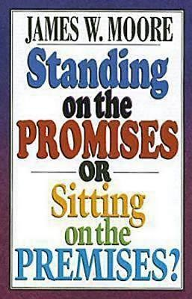
Being where God’s Children Meet, Does Not Make One A Child Of God!

Slide 12
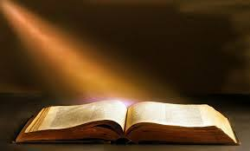
Standing On The
Promises Of God
Obey the Gospel of Christ!
Become an Heir According to Promise – Galatians 3:26,27

